Slide 1
Chicago Car Crash Simulation Study
By Alex Hingtgen & Zak Zahner

Slide 2
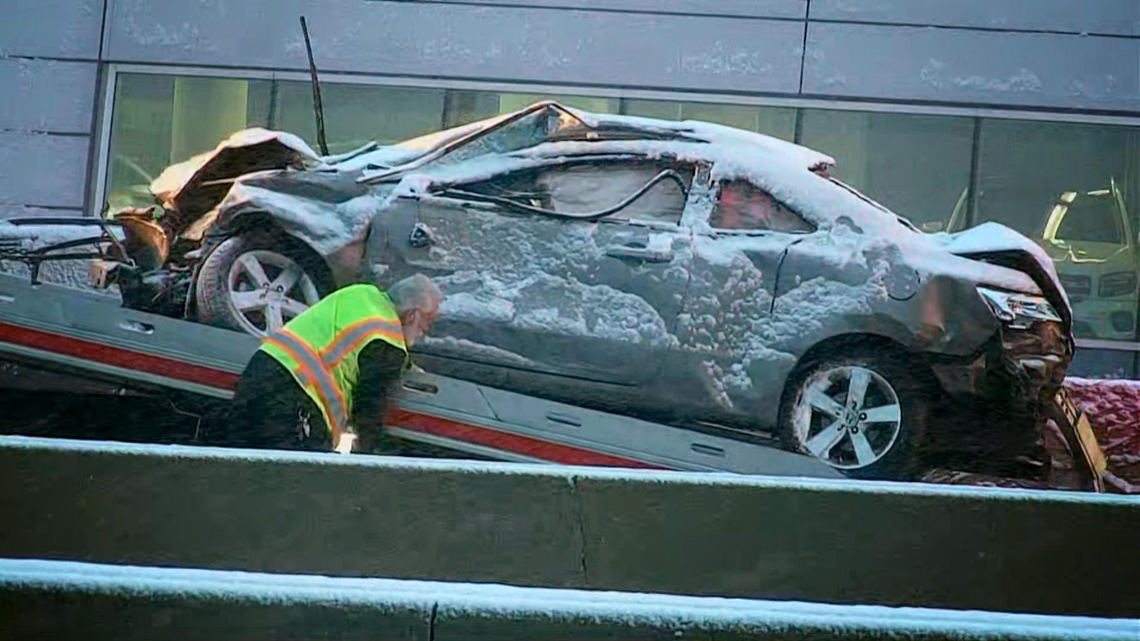
Overview of analysis & problem approached
Problem addressed: Minimizing the risk of being in a car crash & understanding the adverse impacts from car accidents while driving in Chicago and encountering diverse road conditions.
We often travel to Chicago and plan to drive these roads soon
Analyzed factors that can cause a car crash and consequences:
Roadways conditions when dry, wet, snowy/slushy, or icy
Months that resulted in higher crash totals
Level of financial and psychological risk imposed
Used a GUI to enable an interactive analysis of crash data
Notes:
Alex

Slide 3

Input to our program
Data set collected by the City of Chicago on all area crashes
All crashes reported as required by Illinois Department of Transportation
Nearly 500,000 records in the data set that grows daily
Cleaned data to only include crashes from 2020
Reduced data set down to only 91,828 rows
Eliminated variables/columns useless for the study
Used a CSV file from Chicago Data Portal
csv.DictReader and Pandas helped us read the file
Notes:
Alex

Slide 4
Libraries utilized and error handling
Imported tkinter, csv, matplotlib, pandas, and numpy
Each served specific purpose for valuable display or efficient functioning
Error handling was incorporated throughout the code:
Used continue in if statement so function would still run even if data cell were empty
Exception clause used in case file had issues loading
Thus, utilized error messages to pop up when issues did arise
Clear button also serves as last resort
Performed a data cleaning process to prevent errors and altered how data types to enable better analysis (i.e. months)
City of Chicago also uses high standards when inputting data
All data maintained proper format by our review
Notes:
Zahner

Slide 5

Graphical User Interface
Notes:
Alex

Slide 6
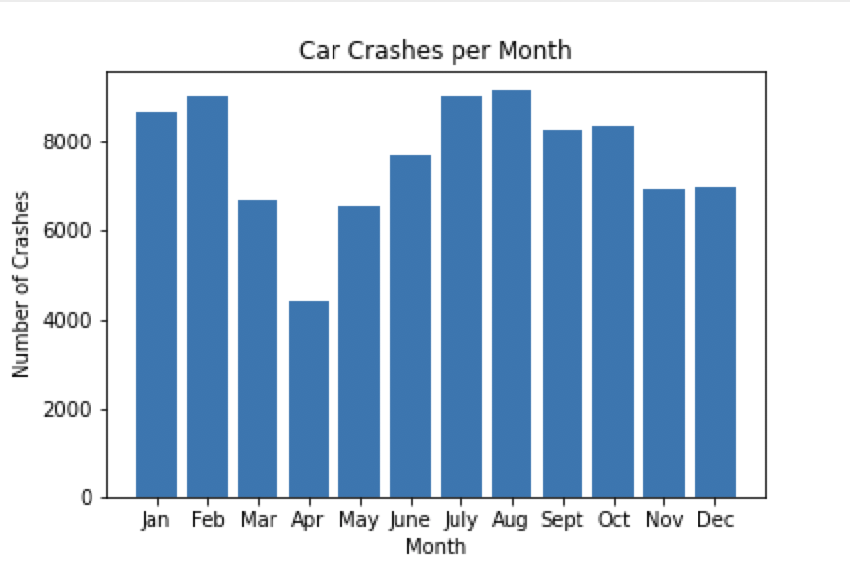
First Question/Function Analyzed
Which months have exhibited an unusually high or low amount of car crashes during the year?
Notes:
Alex

Slide 7
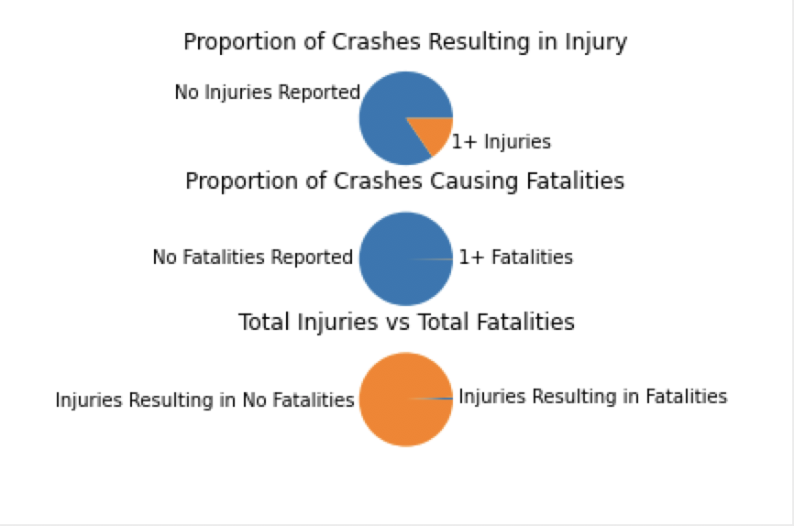
Second Question/Function Analyzed
What proportion of car crashes in the city of Chicago result in injuries and fatalities? What proportion of total injuries from crashes result in fatalities?
Notes:
Alex

Slide 8
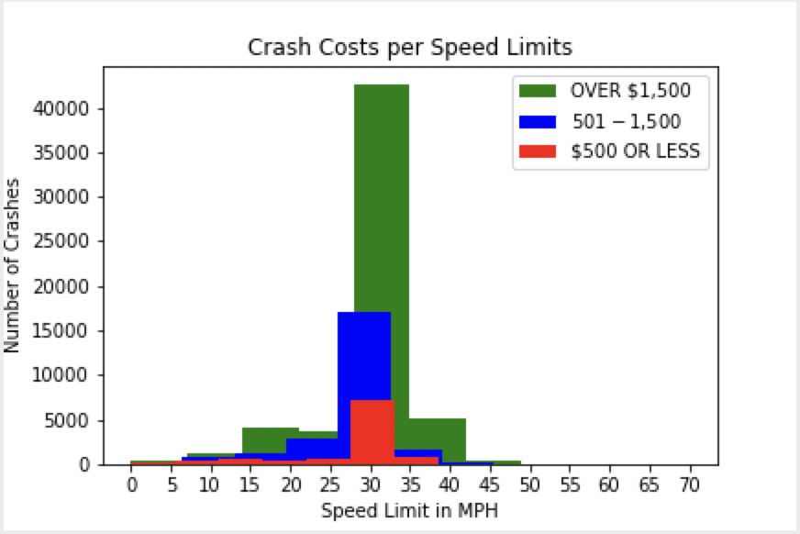
Third Question/Function Analyzed
What speed limit zones result in the highest average crash cost and how many crashes occurred at these costs during the year?
Notes:
Alex

Slide 9
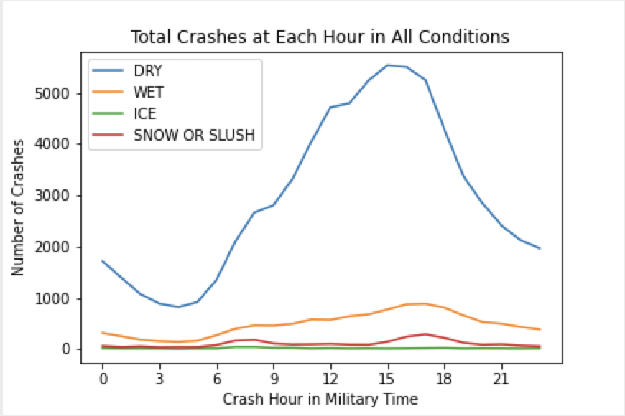
Fourth Question/Function Analyzed
How do specific roadway conditions affect total crashes at each hour throughout the day using military time?
Notes:
Zahner

Slide 10
Reflection: What went well & not so well?
Proud of our radio buttons and the ability to show four meaningful factors
Each roadway condition showed interesting total crash amounts at certain times
Total monthly crashes displayed driving habits and Covid-19 impacts
GUI looked clean and easy to use
Pie chart proportions showing injury/death potential could have shown more detail
Would have liked to break down the fatalities to better show predictability
High amount of crashes at 30 mph limited our histogram analysis
Notes:
Alex

Slide 11
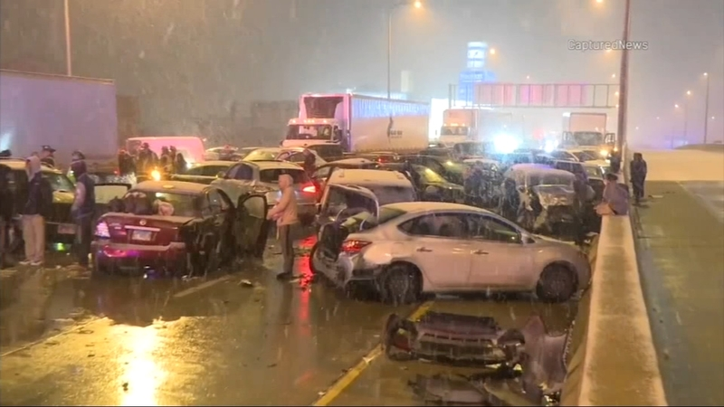
Reflection: What would we do differently?
Utilized more variables and further shown impacts of car crashes
Found ways to simplify our code into less less
Condense functions and reuse code more throughout
Dove deeper into how injuries and fatalities occur
Considered how speed limits impact physical harm
Imported another data set with more specific data on crash damage costs
Notes:
Zahner

Slide 12
Reflection: Lessons Learned & Python Experience
Learned how to make different data displays
Steps in making bar charts, line graphs, histograms, and pie charts
Reinforced our knowledge of GUIs
Better understood how buttons worked and how to clear/load images
Python is a complex coding language and we are still learning
Can be discouraging but many resources to reference for help
Examples from the lecture were key in our implementation
Notes:
Zahner

Slide 13
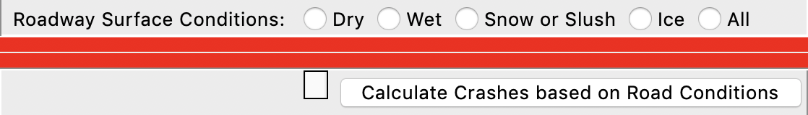
Reflection: Unexpected results & Overall satisfaction
Did not expect certain variables commonalities and broadness
Some data points offered less detail for analysis
Thought our radio button idea would be far less efficient
Almost gave up on the idea
Happy with final product
Believe people can draw real insights from Chicago crash factors and outcomes
We could use our analysis to better our own driving knowledge
Satisfied with our implementation of course concepts
Utilized many resources to compose our code
Notes:
Alex

